Slide 1


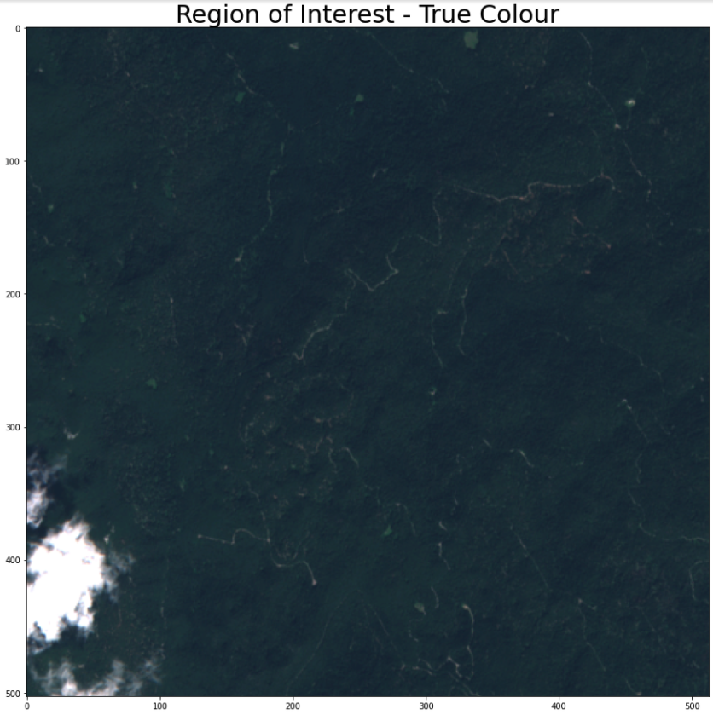
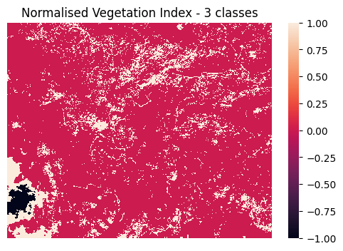
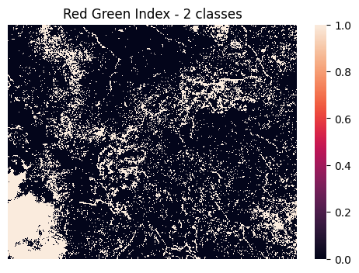
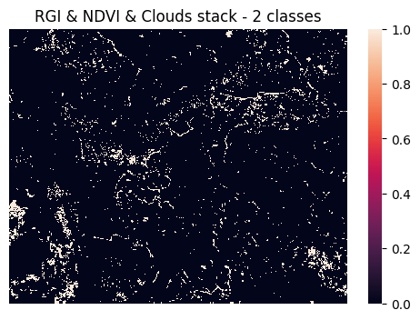
Don’t let the bark beetles bite you!
Monitoring the health of forests using satellite data
Marko H. Mekjavic
Mentor: prof James Garforth
Background
Forests play a vital role in preserving the local as well as global ecosystems, with ever growing importance in times of global warming. However, as every living organism, they are prone to various damaging factors, from heavy storms and droughts to various infections and pests. Bark Beetle has become one of the most damaging factors in pine tree forests, accounting for more tree mortalities than wild-fires.
The main problem in locating infected areas and preventing further outbreak, is the vast area covered with forests. Many organisations resort to very inefficient method of locating trees manually and on foot. A more viable but much pricier solution is conducting search by planes and advanced cameras.
Although there was much research done in using remote-sensing to develop a solution for detecting infected areas, up-to-date there is no off-the-shelf solution that can be used.
Methods
Satellite data was obtained by the Sentinel-2 satellites, part of the the Copernicus satellite programme, and accessed by using the Google Earth Engine and Sentinel Hub platforms.
For the region of interest with infected forest, I chose the regions of Dolenjska and Čabar, located in Central-Eastern Europe between Slovenia and Croatia.
After obtaining the satellite data for the region, I chose the ones wih least clouds. Then the preprocessing of images began. Firstly, I calculated the Reg-Green Index, by using the reflectance in red and green visible light spectrum. Secondly, I calculated the Normalised-Vegetation Index, by comparig the reflectance in red and near infrared spectrum. Using both indices I obtained the areas with a high-likelihood of containing infected trees. Lastly, I masked-out the areas covered with clouds by using the Short-Wave infrared reflectace spectrum.
After obtaining the infected areas, I recalculate the coordinates and return the list.
Objective
The main objective of this project was to create a model that can help local communities in tackling the bark beetle infestations which can detect infected areas of forests, by using publicly available satellite images and provide coordinates of damaged areas.
Results
The main issue at hand is the lack of labelled data – there is no publicly available dataset. However, luckily I was given approximate coordinates to ‘more-infected’ parts of the forests in the region. These areas the model successfully recognised as predominantly infected.
For further testing I decided to compare model’s performance on infected area against its results on the same area prior to thee bark beetle attack. This way I am currently establishing a baseline for infected and uninfected areas in terms of area covered.
Figure 1: Original image of region of interest (Čabar) in True Colour
Figure 3: Normalised-Vegetation Index oof region of interest (Čabar)
White – sparse and unhealthy vegetation
Red – healthy vegetation
Black – bare-soil and man-made construction
Figure 2: Red-Green Index of region of interest (Čabar)
Figure 4: Red-Green and Normalised-Vegetation indices stack of region oof interest (Čabar)
White – low reflectance in green spectrum
Black – high reflectance in green spectrum
White – low reflectance in green spectrum
Black – high reflectance in green spectrum
Red circle – wrongly detected area
Blue circle – correctly detected area
Conclusion
With the initial estimations, the model seems to reasonably detect more condensed areas of damaged forests. However, with the lack of labelled data that is harder to confirm. A better estimation will be provided once the testing against healthier parts of forest will be completed.

